Slide 1
Chapter 03
Magnetic circuits, Mutual inductance, and Transformers

Slide 2
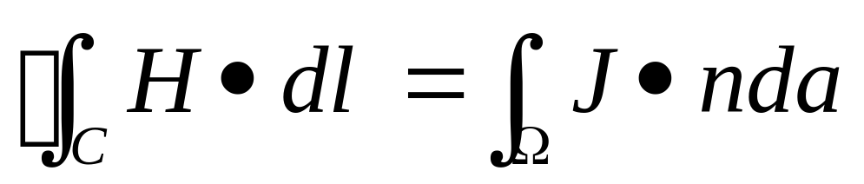
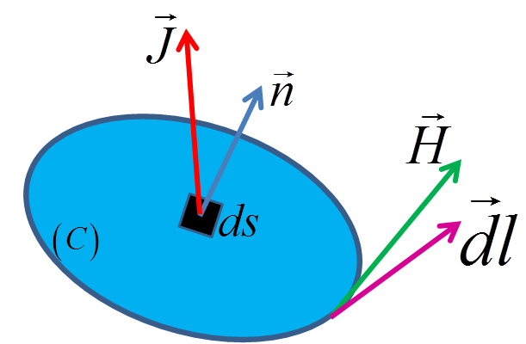
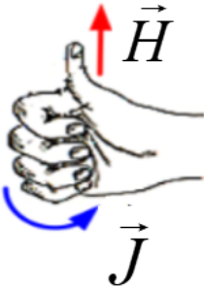
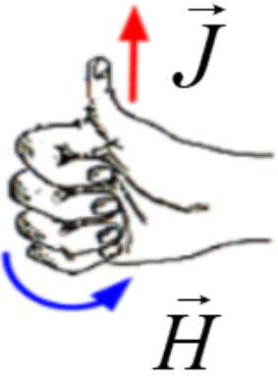
Ampere’s law (1)
Ampere’s law (1)
  Electrical movement
  generates magnetic
  field
Trịnh Hoàng Hơn
ICA Lab

Slide 3
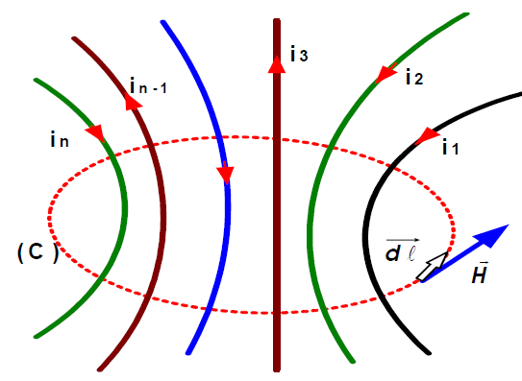
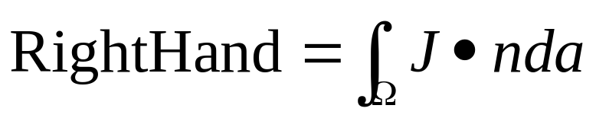
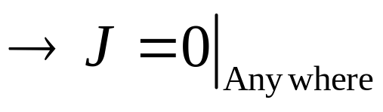
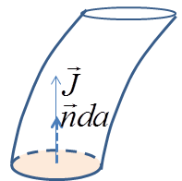
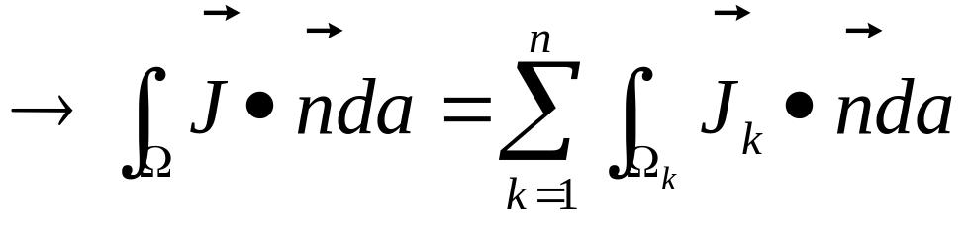

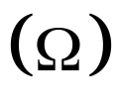
Ampere’s law (2)
Consider the right hand
  Special case,
    Non-metal any where,
      Except cross-sectional area
      of (Ω) and the wire
Trịnh Hoàng Hơn
ICA Lab

Slide 4
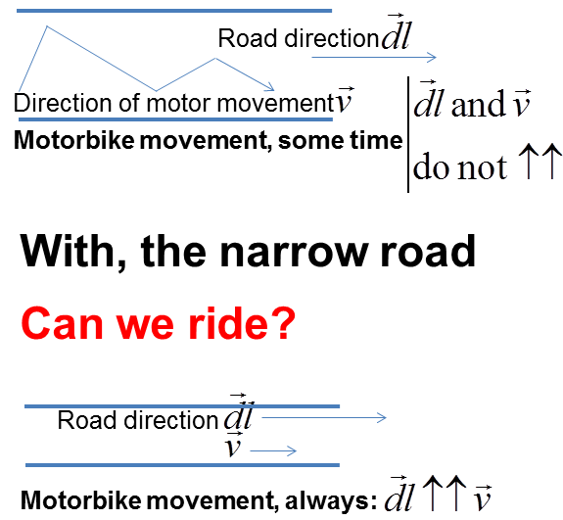
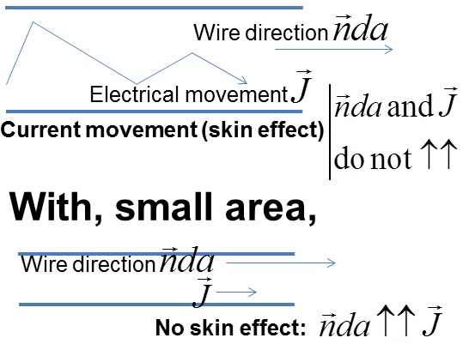
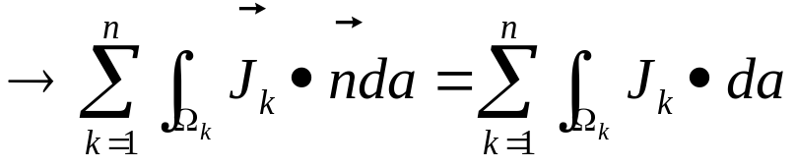
Ampere’s law (3)
Except –cool air?
Example!
Trịnh Hoàng Hơn
ICA Lab

Slide 5
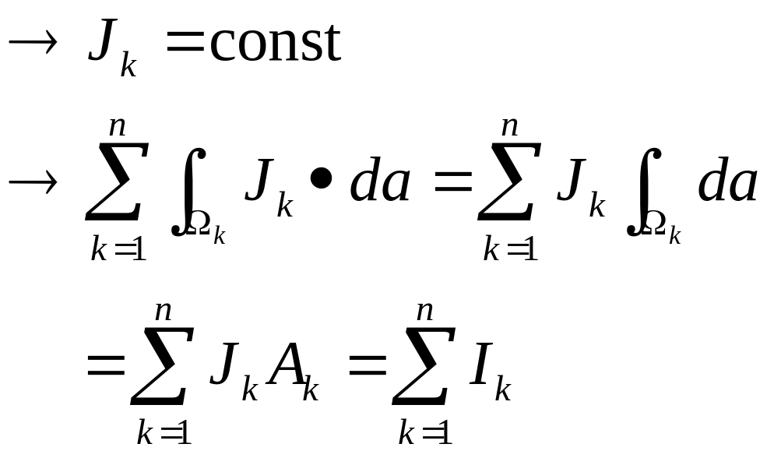
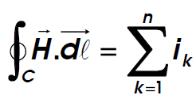
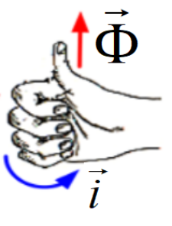
Physical meaning (4)
Furthermore,
  Because of small area,
Consequence
Trịnh Hoàng Hơn
ICA Lab

Slide 6
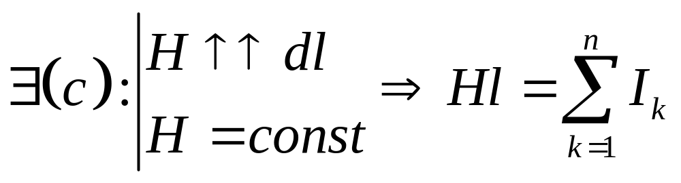
Ampere’s law (5)
Consider the left hand
Special case:
Trịnh Hoàng Hơn
ICA Lab

Slide 7
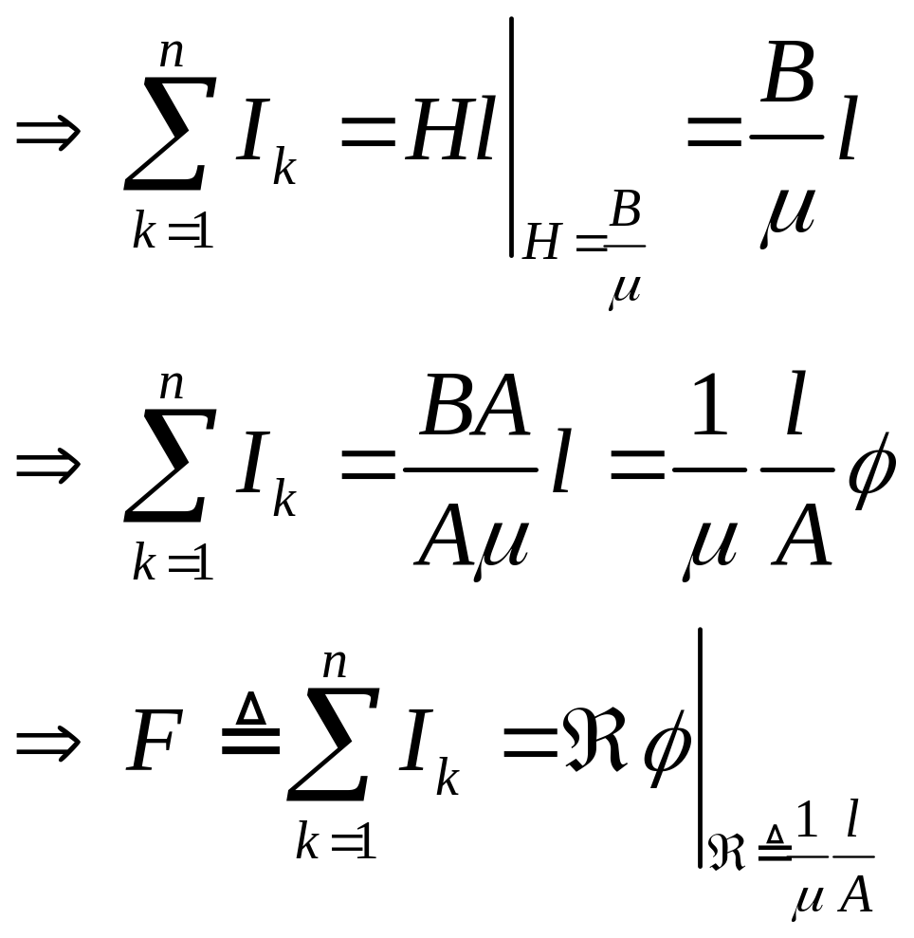
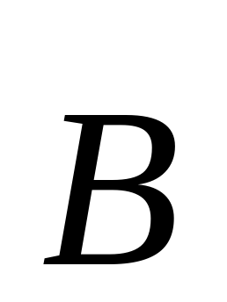

Ampere’s law (6)
Consequence
(3)
Trịnh Hoàng Hơn
ICA Lab

Slide 8
Ampere’s law (6)
Consequence
Where, we define
μ = μ_{r} μ ₀: material permeability
μ₀ = 4π10⁻⁷(H/m): air permeability
A: cross-sectional area
F: magneto motive force (mmf)
ℜ: Reluctance
(3)
Trịnh Hoàng Hơn
ICA Lab

Slide 9
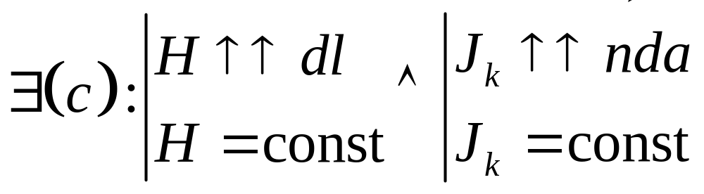
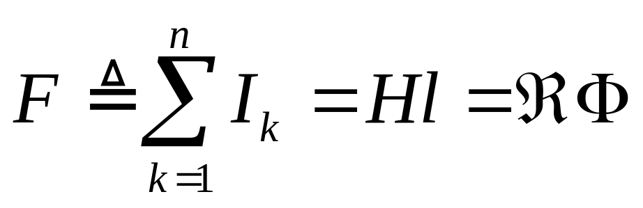
Ampere’s law (7) - Magnetic-Ohm’s Law
Ohm’s law in magnetic field
  Condition:
Ampere’s Law →Magnetic-Ohm’s Law
Trịnh Hoàng Hơn
ICA Lab

Slide 10
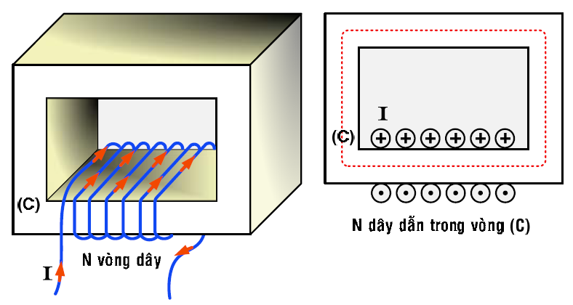
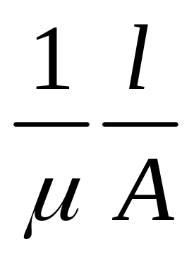
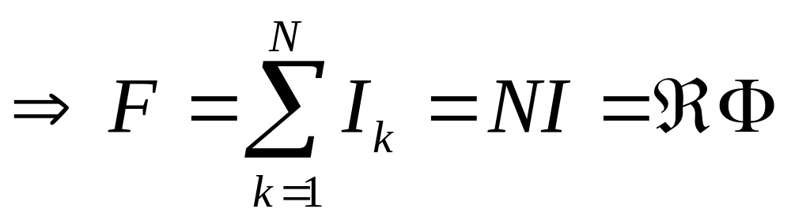
Apply for special model
Satisfy conditions
of Ohm’s Law
Trịnh Hoàng Hơn
ICA Lab

Slide 11
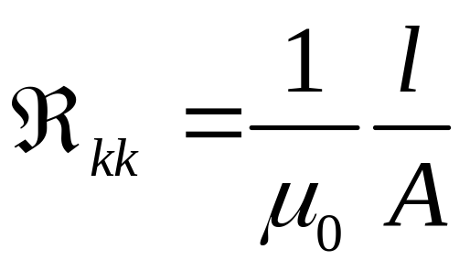
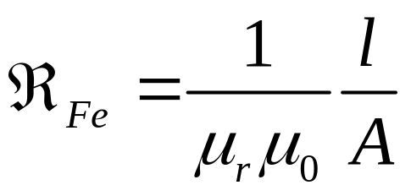
Apply for special model
Trịnh Hoàng Hơn
ICA Lab

Slide 12
Apply for special model
Trịnh Hoàng Hơn
ICA Lab

Slide 13
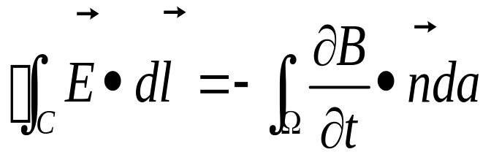
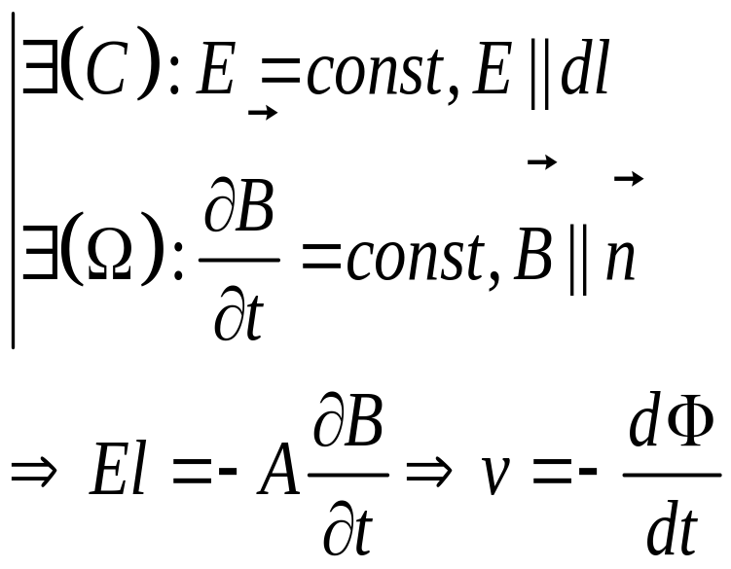
Faraday’s law (1)
Faraday’s law:
  Time-varying in magnetic field
  generates electric field
  Special case
Where,
E (V/m): electric field strength
B: magnetic flux density
v: electromotive force
(4)
Trịnh Hoàng Hơn
ICA Lab

Slide 14
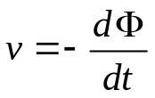
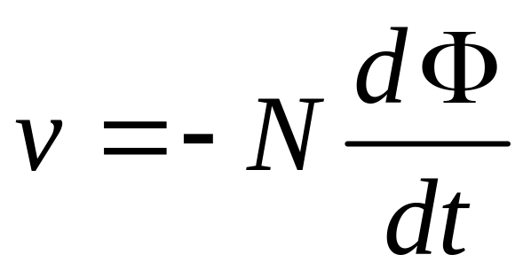
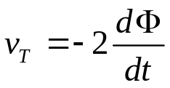
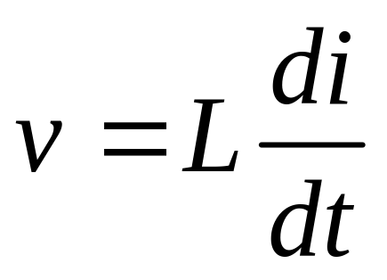
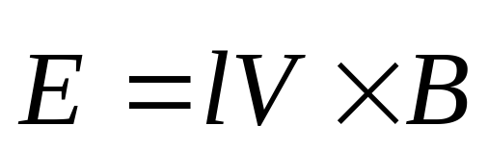
Tổng quát cho N vòng dây
Trịnh Hoàng Hơn
ICA Lab

Slide 15
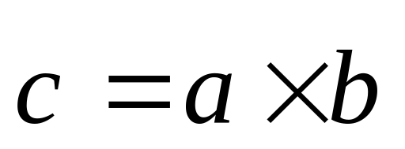











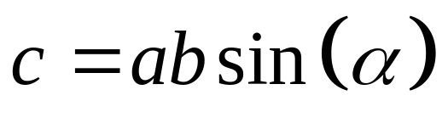
Trịnh Hoàng Hơn
ICA Lab

Slide 16
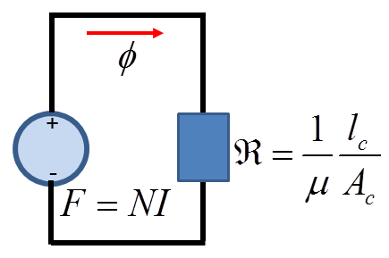
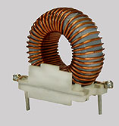
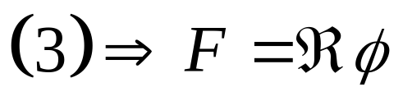
Static magnetic circuits (1)
No moving components in magnetic circuits
Toroid
  N uniformly wound turns
  r₀ and r₁ are inner and outer radii
    mean radius r = (r₀ + r₁) / 2
(5)
Trịnh Hoàng Hơn
ICA Lab

Slide 17
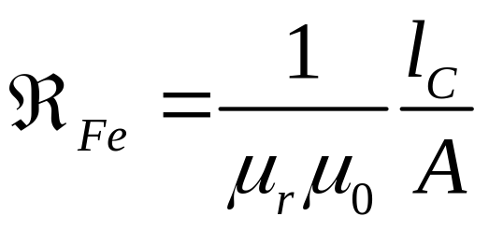
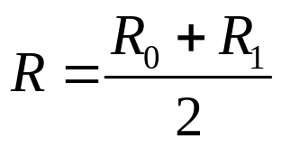
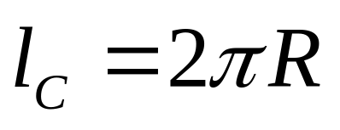
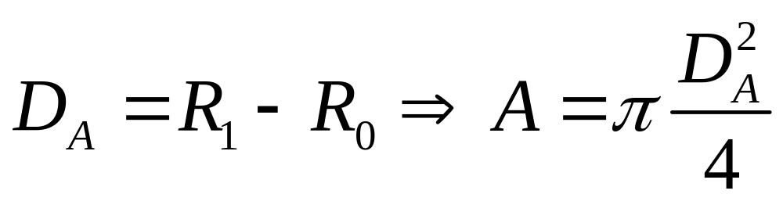
R₁
R
R₀
(C)
Trịnh Hoàng Hơn
ICA Lab

Slide 18
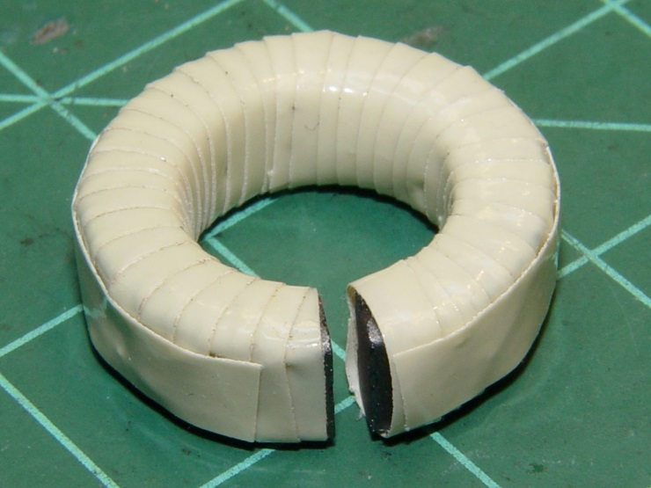
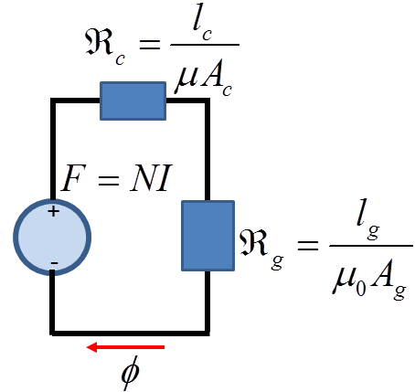
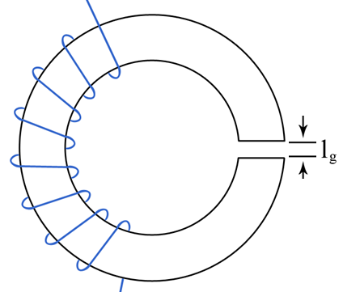
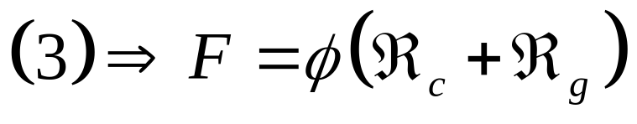
Static magnetic circuits (2)
Toroid with air gap
Trịnh Hoàng Hơn
ICA Lab

Slide 19
Static magnetic circuits (2)
Trịnh Hoàng Hơn
ICA Lab

Slide 20
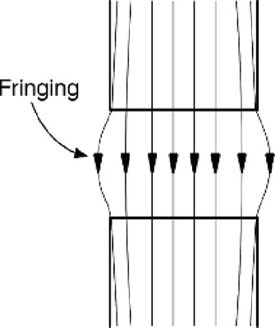
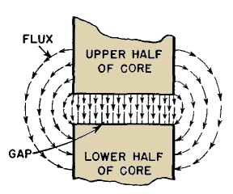
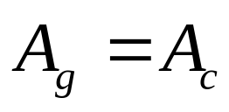
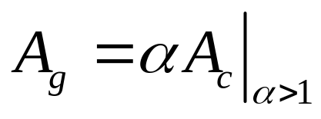
Static magnetic circuits (2)
Toroid with air gap
  Without fringing
  With fringing
Trịnh Hoàng Hơn
ICA Lab

Slide 21

Trịnh Hoàng Hơn
ICA Lab

Slide 22


Examples
Ex.3.1
Trịnh Hoàng Hơn
ICA Lab

Slide 23




Example 2
Reluctance,
→ Using nodal
equations
Trịnh Hoàng Hơn
ICA Lab

Slide 24
Example 2
Trịnh Hoàng Hơn
ICA Lab

Slide 25
Chapter 03 (Cont.)
Mutual inductance

Slide 26







Mutual inductance
Consider, magnetic circuits
Φ₁₁ : total flux
Φ_{l1} : leakage flux
Φ₂₁ : mutual flux
λ₂ : linkage flux
(6)
Trịnh Hoàng Hơn
ICA Lab

Slide 27


Mutual inductance
The other hand
(7)
M₂₁: mutual inductance
Trịnh Hoàng Hơn
ICA Lab

Slide 28

Mutual inductance
Voltage in coil 1
(8)
(9)
(10)
Trịnh Hoàng Hơn
ICA Lab

Slide 29



Mutual inductance
Summary
Similarly, coil 2 is excited
(11)
Trịnh Hoàng Hơn
ICA Lab

Slide 30





Mutual inductance
Both i₁ and i₂ are non-zero
(12)
(12a)
Trịnh Hoàng Hơn
ICA Lab

Slide 31



Mutual inductance
Change the direction of i₂
(12b)
Trịnh Hoàng Hơn
ICA Lab

Slide 32

Mutual inductance
Coefficient of coupling
  Air core ↔ loosely coupled ↔ k<0.5
  Iron core ↔ tightly coupled ↔ k>0.5
(13)
Trịnh Hoàng Hơn
ICA Lab

Slide 33

Lenz’s law
Lenz’s law:
  If Φ₁ → e₂ → i₂ → Φ₂ (e₂: induced voltage)
    Then e₂ polarity (i₂ direction) is established such that Φ₂↑↓ Φ₁
Determine polarity
of e₂ is
necessary?
Trịnh Hoàng Hơn
ICA Lab

Slide 34


Polarity markings (dot convention)
  Two problems
      Given the coil configuration,
        Determine the dot markings (Conventional polarity of two coils)
      Given the dot markings,
        How to used for writing equations?.
dot
dot
+
Trịnh Hoàng Hơn
ICA Lab

Slide 35

Polarity markings (dot convention)
How to determine?
  Conventional polarity is correctly selected
    Two currents flowing into the dotted terminals
      Both generated directions are additive
Which one?
Trịnh Hoàng Hơn
ICA Lab

Slide 36
Polarity markings (dot convention)
  Conventional polarity of two coils are marked by dots
    If a current flowing into the selected dot terminal of one coil
    Then the dotted terminal of another coil is positive polarity of induced voltage
dot
dot
+
-
Trịnh Hoàng Hơn
ICA Lab

Slide 37



Polarity markings (dot convention)
Consequence
      Given the dot markings,
        How they are used to write the equations.
(14)
Trịnh Hoàng Hơn
ICA Lab

Slide 38



Polarity markings (dot convention)
Consequence
      Given the dot markings,
        How they are used in writing equations.
(15)
Trịnh Hoàng Hơn
ICA Lab

Slide 39
Thanks!
Trịnh Hoàng Hơn
ICA Lab

Slide 40
Resistance: điện trở
  Resistor: điện trở
Inductance: điện cảm
  Reactance: điện kháng
Capacitance: điện dung
  Capacitive: Tính dung
Reluctance: từ trở
Trịnh Hoàng Hơn
ICA Lab

